Slide 1
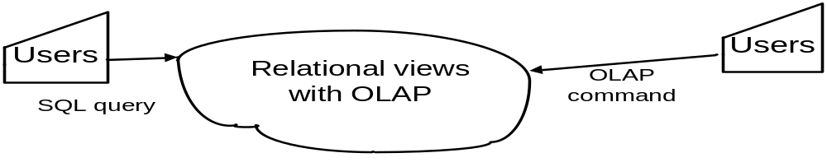
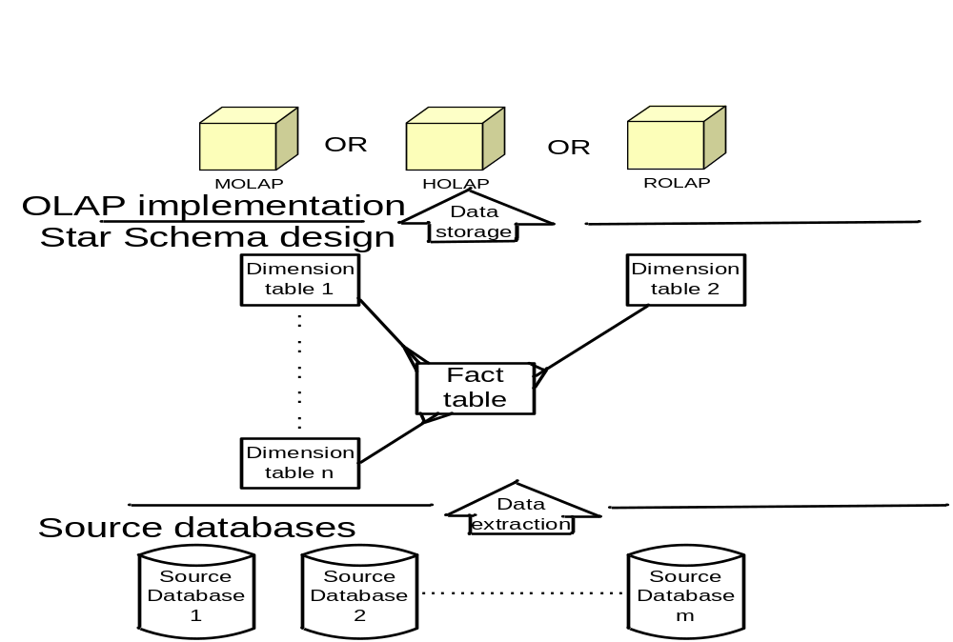
Architecture of Three Tier Data Warehouse
----------------------------------------------Top Tier Front-end Processing---
----Middle Tier – OLAP Server---
-Bottom Tier–Data Warehouse Server-

Slide 2
Data Warehouse for Decision Support
A data base is a collection of data organized by a database management system.
A data warehouse is a read-only analytical database used for a decision support system operation.
A data warehouse for decision support is often taking data from various platforms, databases, and files as source data. The use of advanced tools and specialized technologies may be necessary in the development of decision support systems, which affects tasks, deliverables, training, and project timelines.

Slide 3
Data Warehouse for end users
A data warehouse is readily user-friendly by the analyst for end users, even those who are not familiar with database structure.
Data warehouse is a collection of integrated de-normalized databases for fast response performance.
In general, a data warehousing storage is for at least 5 years long term capacity planning growth.

Slide 4
Phases of the Decision Support Life Cycle
1. Planning
2. Gathering Data Requirements and Modeling
3. Physical Database Design and Development
4. Data Mapping and Transformation
5. Data Extraction and Load
6. Automating the Data Management Process
7. Application Development-Creating the starter sets of reports
8. Data Validation and Testing
9. Training
10. Rollout

Slide 5
Phase 1: Planning
Planning for a data warehouse is concerned with:
Defining the project scope
Creating the project plan
Defining the necessary resources, both internal and external
Defining the tasks and deliverables
Defining timelines
Defining the final project deliverables

Slide 6
Capacity Planning
Calculate the record size for each table
Estimate the number of initial records for each table
Review the data warehouse access requirements to predict index requirements
Determine the growth factor for each table
Identify the largest target table expected over the selected period of time and add approximately 25-30% overhead to the table size to determine temporary storage size

Slide 7
Phase 2: Gathering data requirements and Modeling
Gathering Data Requirements:
How the user does business?
How the user’s performance is measured?
What attributes does the user need?
What are the business hierarchies?
What data do users use now and what would they like to have?
What levels of detail or summary do the users need?

Slide 8
Data Modeling
A logical data model covering the scope of the development project including relationships, cardinality, attributes, and candidate keys.
or
A Dimensional Business Model that diagrams the facts, dimensions, hierarchies, relationships and candidate keys for the scope of the development project

Slide 9
Phase 3: Physical Database Design and Development
Designing the database, including fact tables, relationship tables, and description (lookup) tables.
Denormalizing the data.
Identifying keys.
Creating indexing strategies.
Creating appropriate database objects.

Slide 10
Phase 4: Data Mapping and Transformation
Defining the source systems.
Determining file layouts.
Developing written transformation specifications for sophisticated transformations.
Mapping source to target data.
Reviewing capacity plans.

Slide 11
Phase 5: Populating the data warehouse
Developing procedures to extract and move the data.
Developing procedures to load the data into the warehouse.
Developing programs or use data transformation tools to transform and integrate data.
Testing extract, transformation and load procedures

Slide 12
Phase 6: Automating Data Management Procedures
Automating and scheduling the data load process.
Creating backup and recovery procedures.
Conducting a full test of all of the automated procedures.

Slide 13
Phase 7: Application Development - Creating the Starter Set of Reports
Creating the starter set of predefined reports.
Developing core reports.
Testing reports.
Documenting applications.
Developing navigation paths.

Slide 14
Phase 8: Data Validation and Testing
Validating Data using the starter set of reports.
Validating Data using standard processes.
Iteratively changing the data.

Slide 15
Phase 9: Training
To gain real business value from your warehouse development, users of all levels will need to be trained in:
The scope of the data in the warehouse.
The front end access tool and how it works.
The DSS application or starter set of reports - the capabilities and navigation paths.
Ongoing training/user assistance as the system evolves

Slide 16
Phase 10: Rollout
Installing the physical infrastructures for all users.
Developing the DSS application.
Creating procedures for adding new reports and expanding the DSS application.
Setting up procedures to backup the DSS application, not just the data warehouse.
Creating procedures for investigating and resolving data integrity related issues.

Slide 17
Star Schema Database Design
The goals of a decision support database are often achieved by a database design called a star schema. A star schema design is a simple structure with relatively few tables and well-defined join paths. This database design, in contrast to the normalized structure used for transaction-processing databases, provides fast query response time and a simple schema that is readily understood by the analysts and end users.

Slide 18
Understanding Star Schema Design - Facts and Dimensions
A star schema contains two types of tables, fact tables and dimension tables. Fact tables contain the quantitative or factual data about a business - the information being queried. This information is often numerical measurements and can consist of many columns and millions of rows. Dimension tables are smaller and hold descriptive data that reflect the dimensions of a business. SQL queries then use predefined and user-defined join paths between fact and dimension tables to return selected information.

Slide 19
Identifying Facts and Dimensions
Look for the elemental transactions within the business process. This identifies entities that are candidates to be fact table.
Determine the key dimensions that apply to each fact. This identifies entities that are candidates to be dimension tables.
Check that a candidate fact is not actually a dimension with embedded facts.
Check that a candidate dimension is not actually a fact table within the context of the decision support requirement.

Slide 20
Step 1 Look for the elemental transactions within the business process
The first step in the process of identifying fact tables is where we examine the business, and identify the transactions that may be of interest. They will tend to be transactions that describe events fundamentals to the business.

Slide 21
Step 2 Determine the key dimension that apply to each fact
The next step is to identify the main dimensions for each candidate fact table. This can be achieved by looking at the logical model, and finding out which entities are associated with the entity representing the fact table. The challenge here is to focus on the key dimension entities.

Slide 22
Step 3 Check that a candidate fact is not actually a dimension table with denormalized facts
Look for denormalized dimensions within candidate fact tables. It may be the case that the candidate fact table is a dimension containing repeating groups of factual attributes.

Slide 23
Step 4 Check that a candidate dimension is not a fact table
If the business requirement is geared toward analysis of the entity that is currently a candidate dimension, chances are that it is probably more appropriate to make it a fact table.

Slide 24
Simple Star Schemas
Each table must have a primary key, which is a column or group of columns whose contents uniquely identify each row. In a simple star schema, the primary key for the fact table is composed of one or more foreign keys. When a database is created, the SQL statements used to create the tables will designate the columns that are to form the primary and foreign keys.

Slide 25
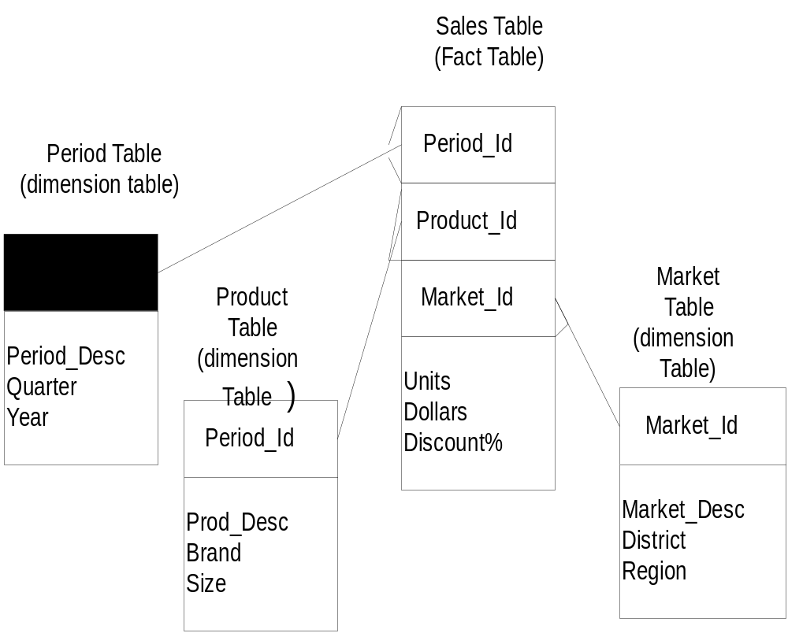

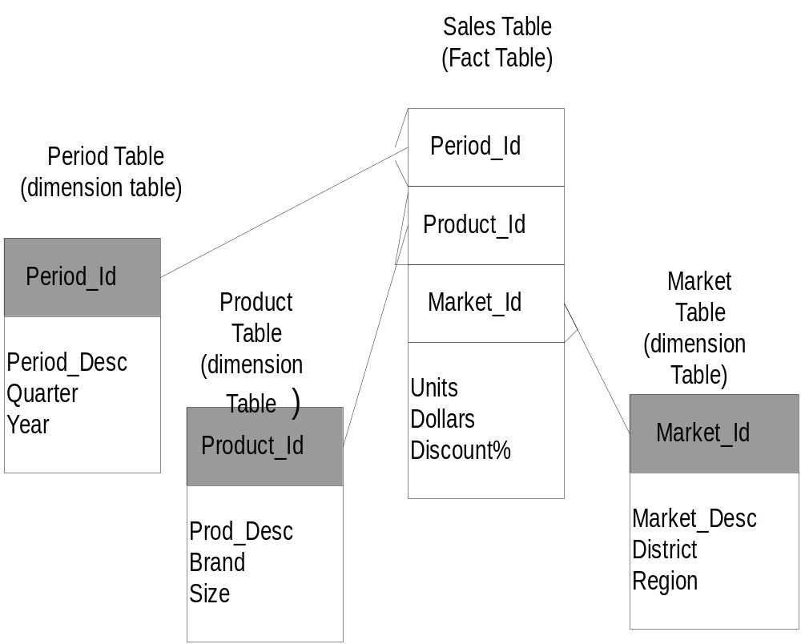
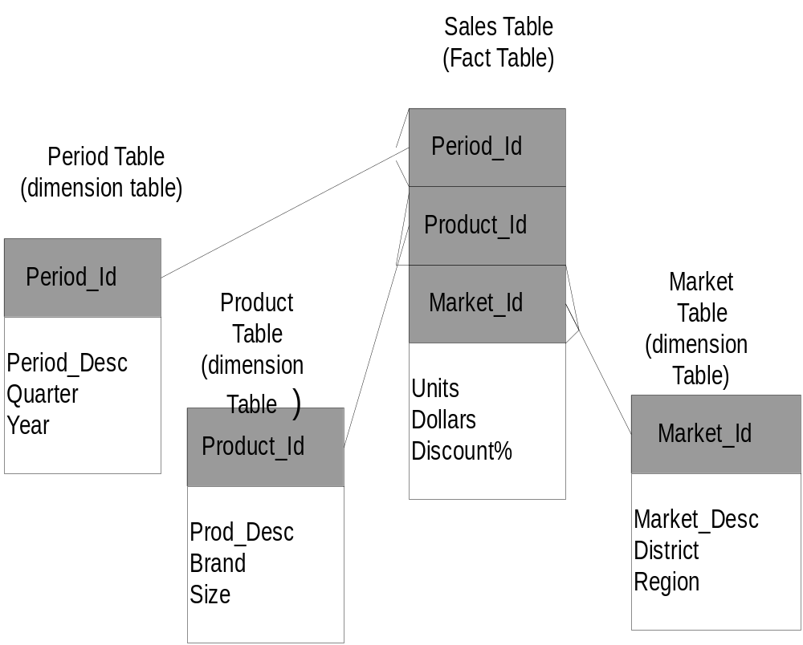
A sales database with a simple star schema

Slide 26
Multiple Fact Tables
A star schema can contain multiple fact tables.
Multiple fact tables exist because they contain unrelated facts or because periodicity of the load times differs. In other cases, multiple fact tables exist because they improve performance. Creating different tables for different levels of aggregation is a common design technique for a data warehouse database so that any single request is against a table of reasonable size.

Slide 27
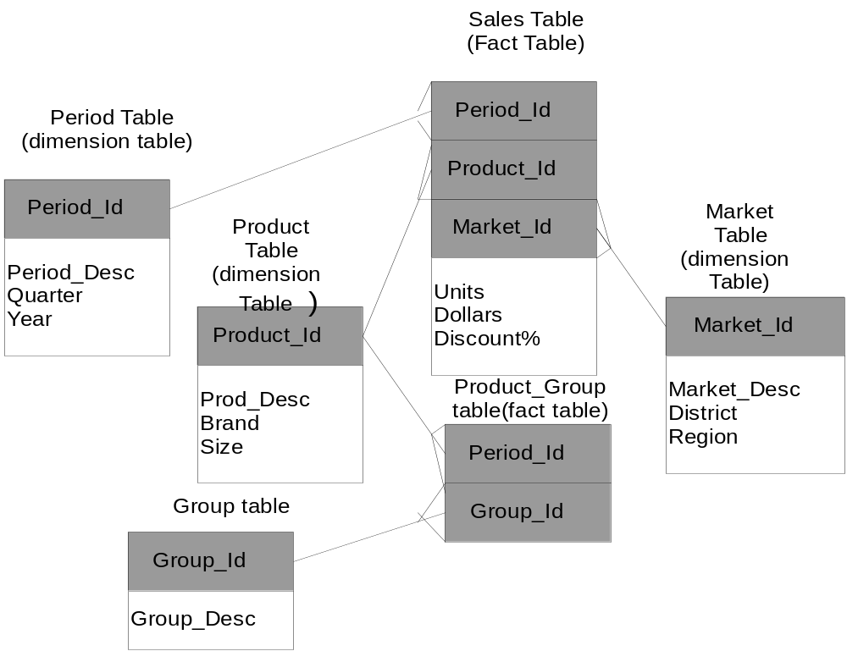

Slide 28
Outboard Tables
Dimension tables can also contain a foreign key that references the primary key in another dimension table. The referenced dimension tables are sometimes referred to as outboard, outrigger, or secondary dimension tables.

Slide 29
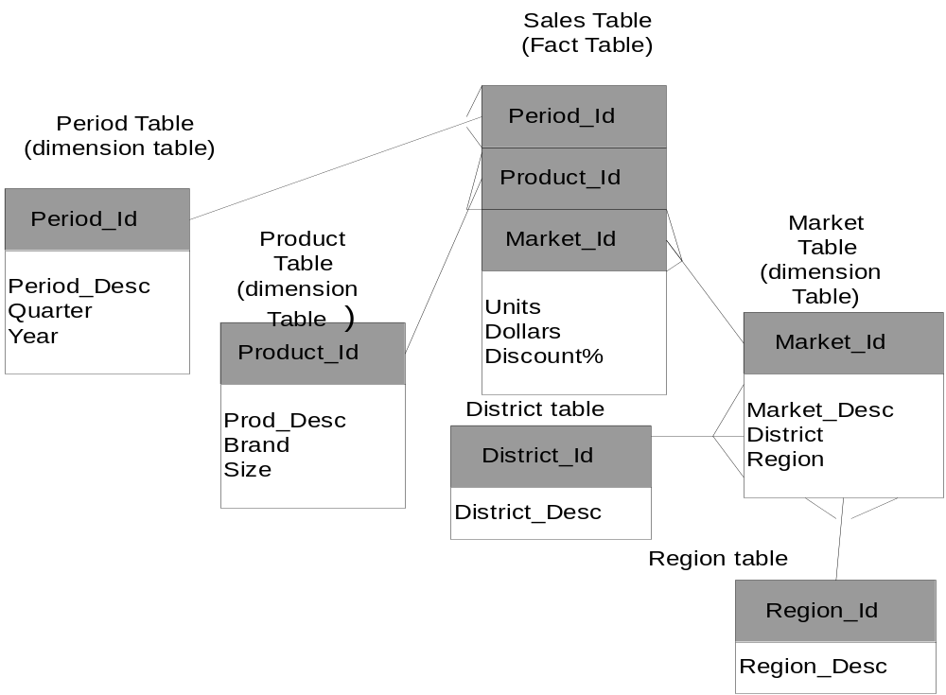

Slide 30
Multi-Star Schema
In some applications the concatenated foreign keys might not provide a unique identifier for each row in the fact table. These applications require a multi-star schema.
In a multi-star schema, the fact table has both a set of foreign keys, which reference dimension tables, and a primary key, which is composed of one or more columns that provide a unique identifier for each row.

Slide 31
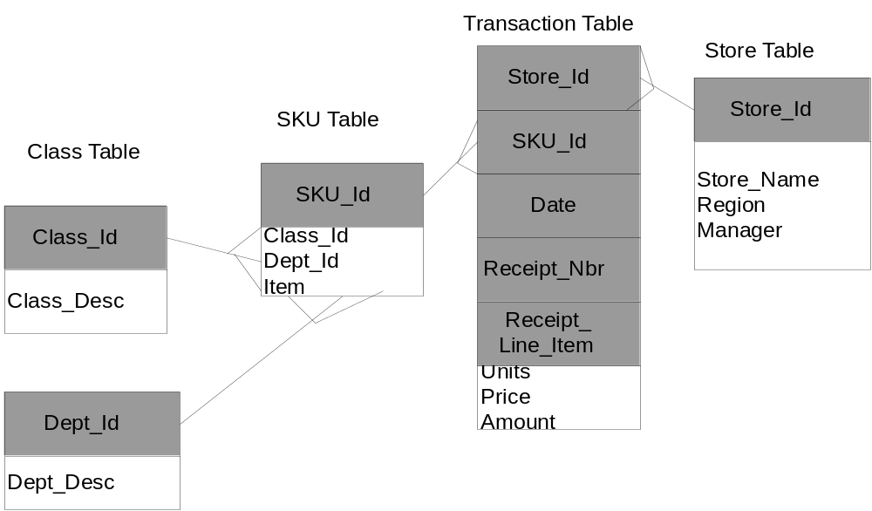
Retail sales database designed as a multi-star schema with two secondary dimension tables

Slide 32
Snowflake Schema
Snowflake schema is a star schema which stores all dimensional information in third normal form, while keeping fact table structures the same.

Slide 33
Example of Snowflake Schema
time
item
time_key
day
day_of_the_week
month
quarter
year
item_key
item_name
brand
type
supplier_key
supplier
Sales Fact Table
supplier_key
supplier_type
time_key
item_key
branch_key
branch
location
location_key
location_key
street
city_key
branch_key
branch_name
branch_type
units_sold
city
dollars_sold
city_key
city
province_or_street
country
avg_sales
Measures

Slide 34
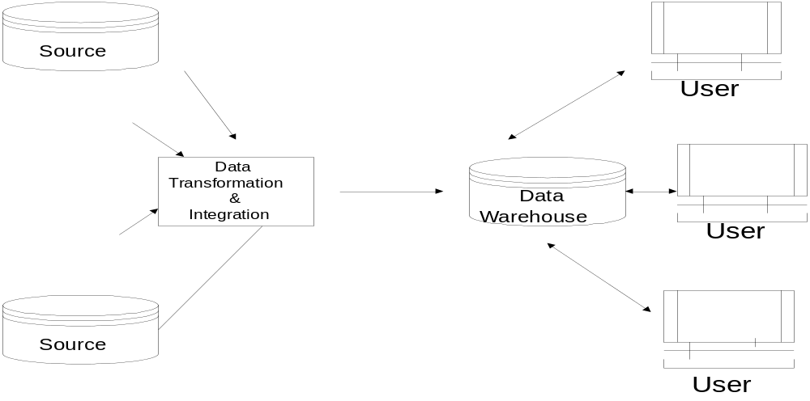
Data Warehouse architectures
Source

Slide 35
Case study of building a data warehouse
Step 1 Planning

Slide 36
Capacity planning
Given time dimension: 2 years x 365 days
Product dimension: average 5 product per transaction
Promotion dimension: 1 promotion type per transaction
Store dimension: 10 local country stores
Customer dimension: 1 customer per transaction
Number of sales transaction: 200 per day for major customers
As a result, the number of base fact records = 2 x 365 x 5 x 1 x 200 = 7.3 million records
Assume number of key field = 5, number of fact field = 7, which implies total fields = 12
Thus, the base fact table size = 7.3 million x 12 x 4 bytes per field = 350 MB (the size of dimension tables are negligible).

Slide 37
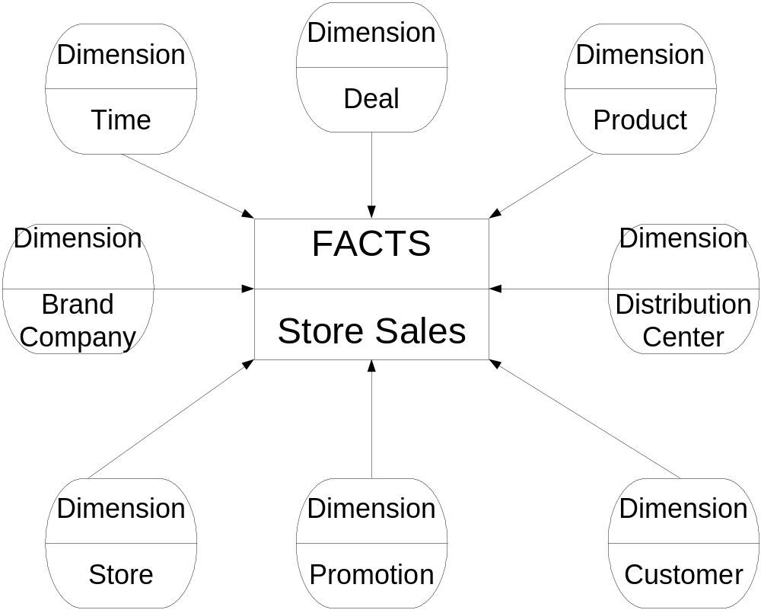
Step 2 Data Requirements and Modeling

Slide 38
Example: Design a Simple Star Schema from a relational schema
Step 3 Physical database design and development
Identify measurable fields in a Fact table.
Identify selection criteria of the measurement as keys in a Fact table.
Construct the dimension tables derived from the keys in the Fact table.
Validate the Simple Star Schema as SR1 type relation.

Slide 39
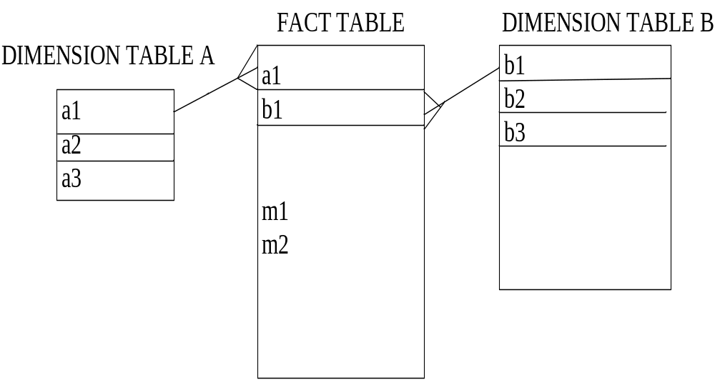
Example
Given
Relation A (a1, a2, a3)
Relation B (b1, b2, b3)
Relation C (*a1, *b1, m1, m2)
Derived Simple Star Schema

Slide 41
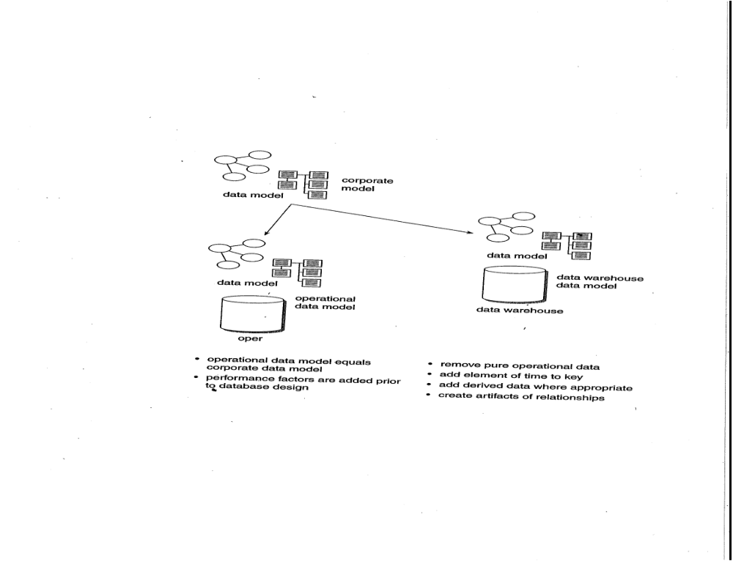
Step 4 Map Corporate model into a data warehouse
Data Mapping and Transformation

Slide 42
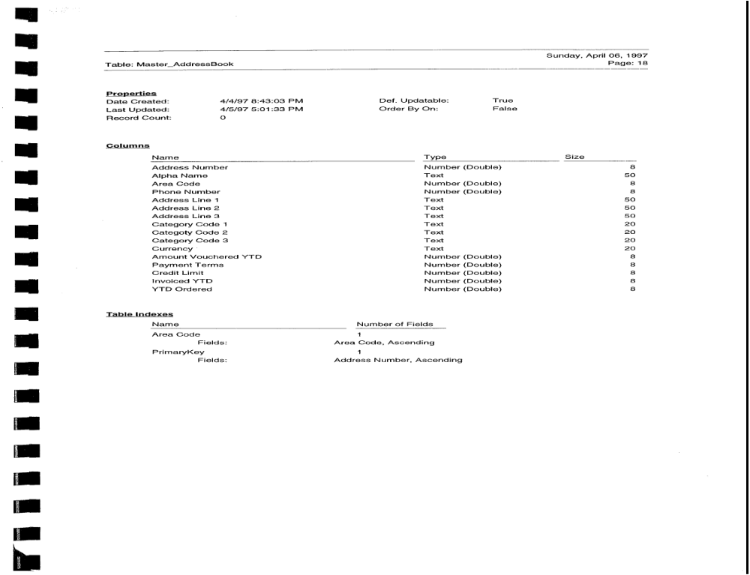

Slide 43
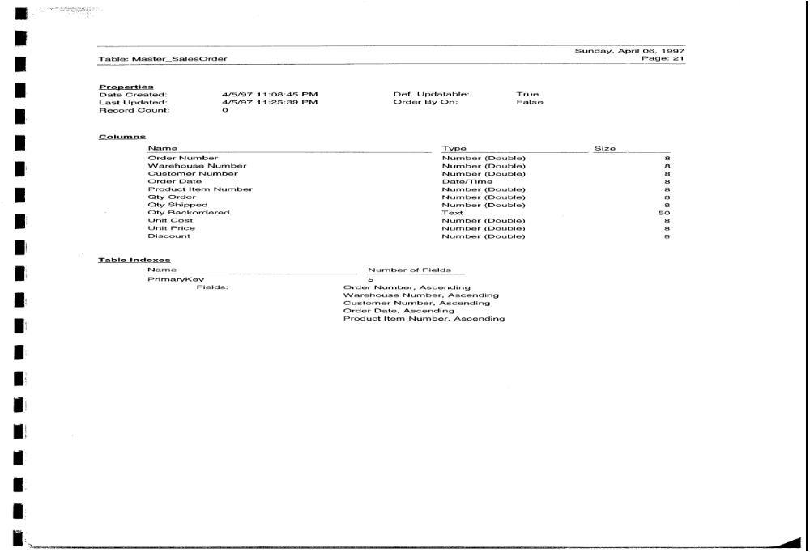

Slide 44
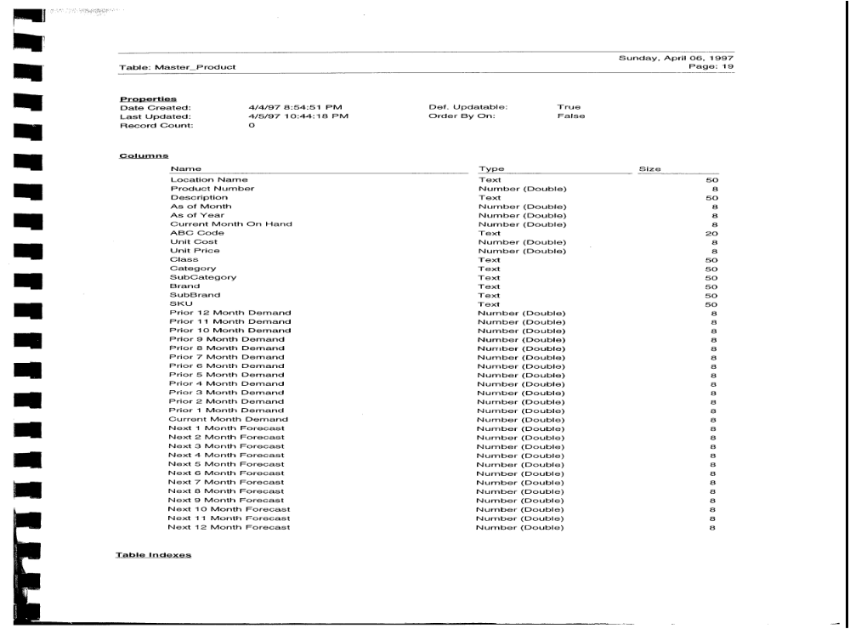

Slide 46
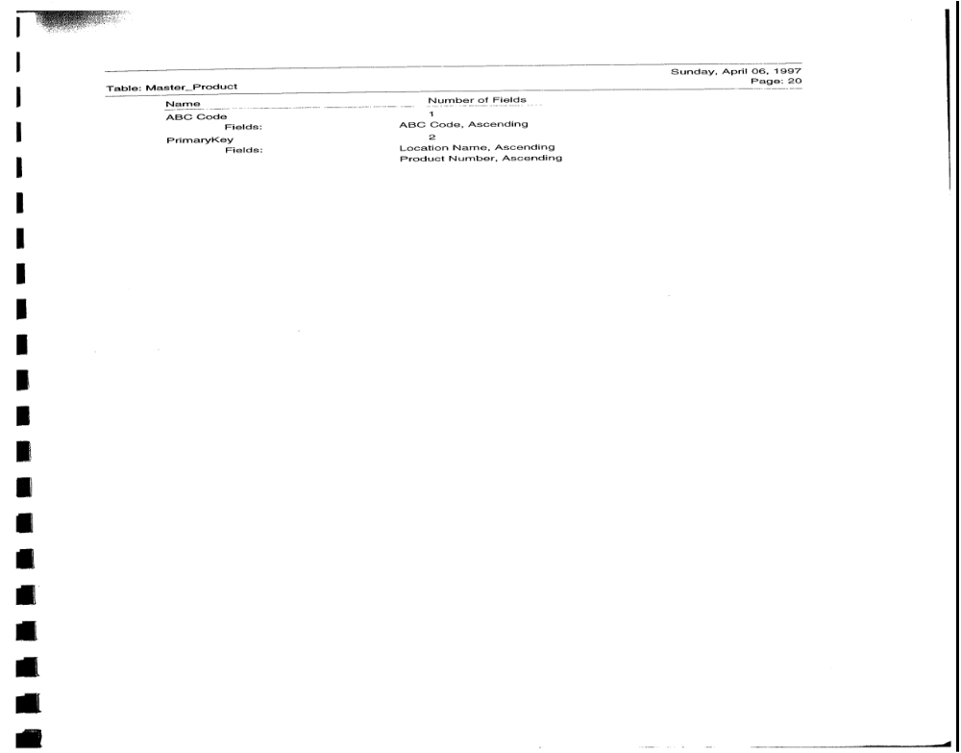

Slide 47
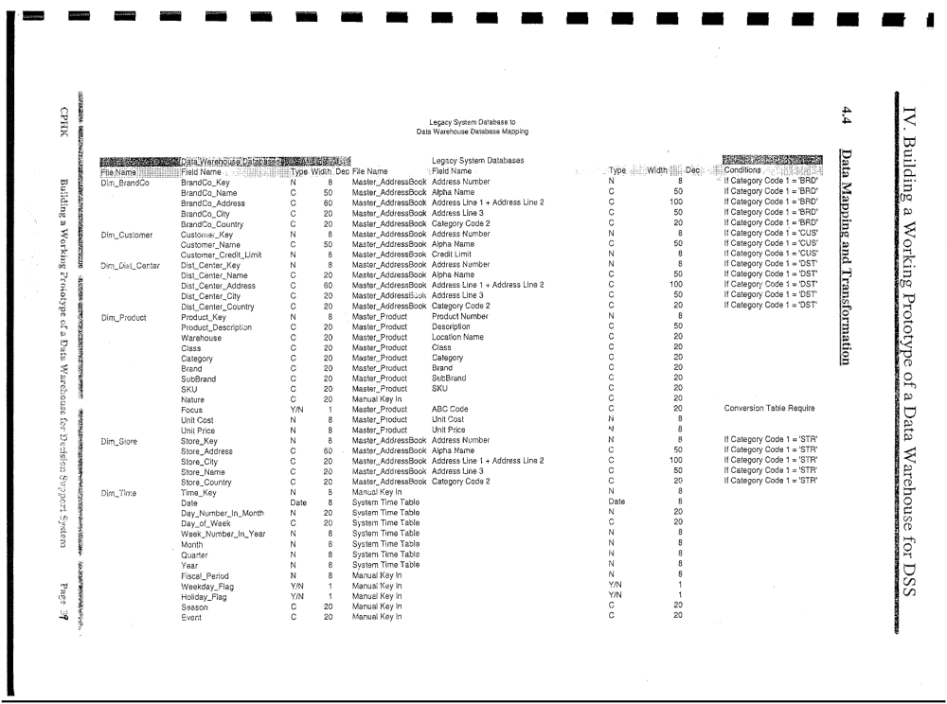

Slide 48
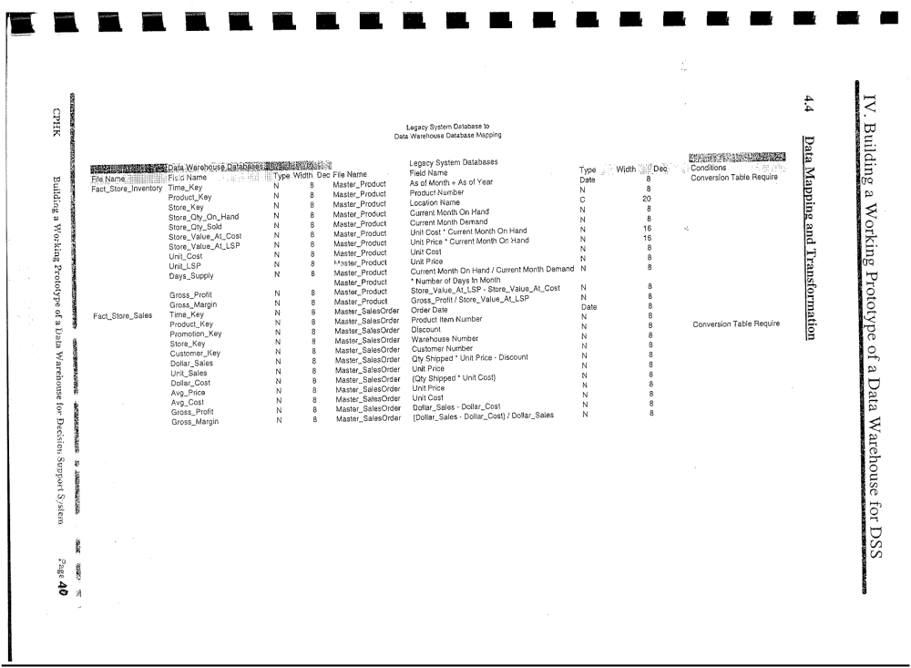

Slide 49
Step 5 Data Extraction and Load
Technical infrastructures should be in place to assist with these middle phases of data mapping, transformation, extracting and loading including:
Database administration expertise
Data transformation tool training / expertise
Update / refresh strategies
Load strategies
Operations /job scheduling
Quality assurance procedures
Capacity planning expertise

Slide 50
Step 6 Automating Data Management Process
A data warehouse has very bimodal usage. Most data warehouses are online 16 to 22 hours per day in a read-only mode. The data warehouse goes off-line for 2 to 8 hours in the wee hours of the morning for data loading, data indexing, data quality assurance, and data release.

Slide 51
Step 7 Application Development-Creating starter set of reports
Reports for Executive Information Systems such as:
Is it worthwhile to stock so many individual sizes of certain products?
Which items are cannibalized when I promote a particular product like Absolute Vodka?
What are the top 10 items my competitors are selling that I don’t sell at all?
Which season sold the most Cognac last year?
Which product item is the most profitable in year 2001 in Macau?
Which customer/Outlet buy the most in terms of cases sales in year 2001?
What is the total gross profit in April this year?

Slide 52
Reading assignment
“Data Mining: Concepts and Techniques”, by Jiawei Han and Micheline Kamber, Morgan Kaufmann Publishers, 2nd edition, 2007, Chapter 3 Data Warehouse and OLAP Technology, pp.105-134

Slide 53
Lecture review question 4
Compare database with data warehouse in performance, user friendliness, capacity planning and data manipulation language operations?

Slide 54
Tutorial Question 4
You are to design a data warehouse to track the sales of salad dressing products in supermarkets at weekly intervals over a four-year period and it is a typical consumer-goods marketing database. The salad dressing product category contains 14000 items at the universal product code (UPC) level. Data are summarized for each of 120 geographic areas (markets) in the United States, and are also summarized for each of 208 weekly time periods spanning over four years. The followings are the tables:
Product Table (Product_id, Prod_Desc, Brand, Manufacturer, Pack, Class, Flavor, Size)
Sales Table (*Period_id, *Product_id, *Market_id, Units, Dollars, Discount, Selling_Price,
Large_Ads, Medium_Ads, Small_Ads)
Period Table (Period_id, Period_Desc, Quarter, Fiscal_Year, Calendar_Year, Agg_Level)
Market Table (Market_id, Market_Desc, District, Region)
Show a simple star schema design for the application.

